Slide 1
Placenta and foetal circulation
Prof. Aranjan Karunanayake
MBBS, DM, DOH&S, Dip.Tox, Dipin. Coun, D.Sp.Med, FSS, MBASEM (UK), Msc.SEM (UK)

Slide 2
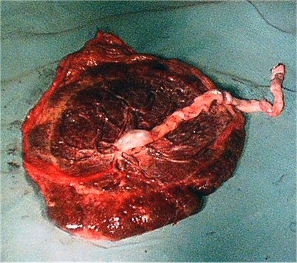
Placenta

Slide 3
Functions of placenta-
Enables foetus to take oxygen and nutrients from maternal blood.
Serves as an excretory organ.
Forms a barrier against the transfer of infection.
Secretes a large amount of HCG, oestrogen, progesterone. Also secretes various other hormones which help to maintain the decidua, growth of uterus and breasts.
Structure-
Placenta has a maternal and a foetal part. Maternal part is decidua. Foetal part is chorion. Chorion is formed by trophoblast and extra embryonic mesoderm.

Slide 4
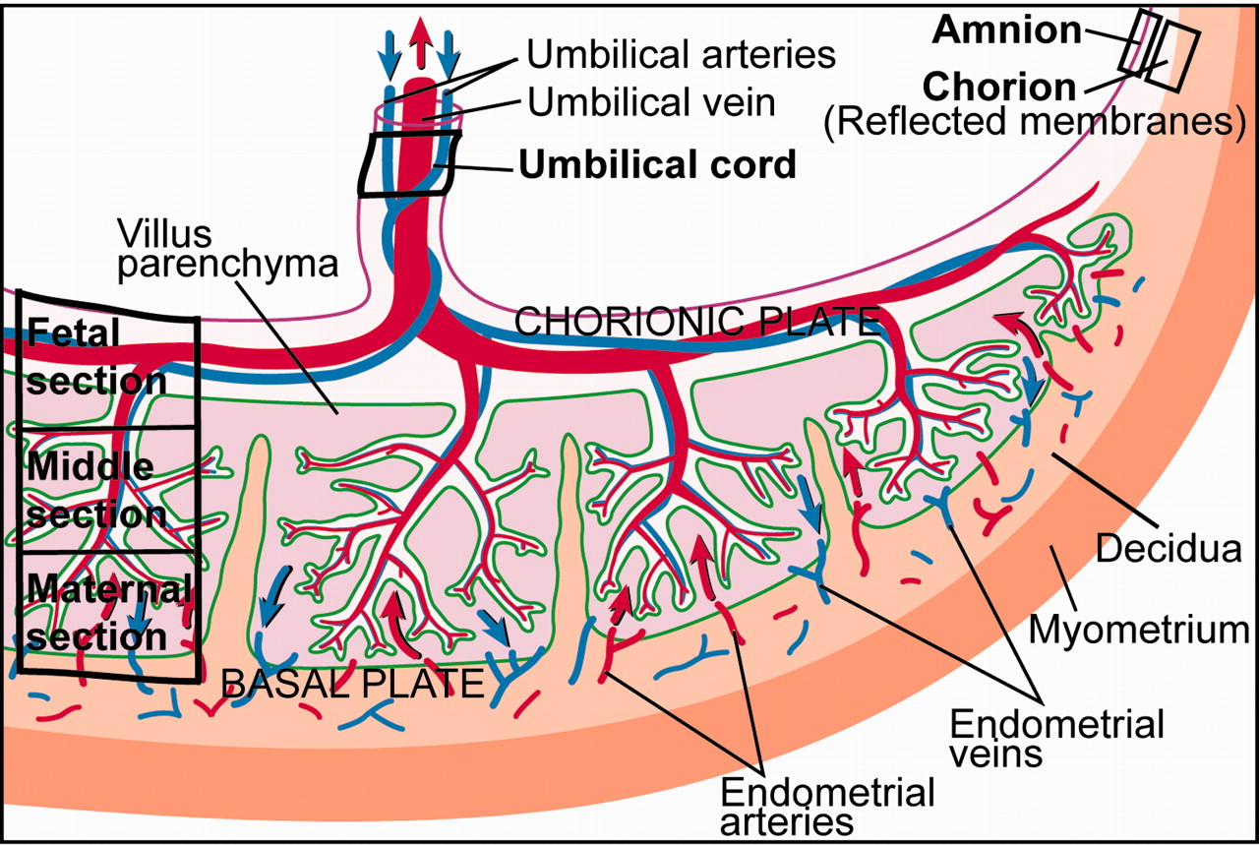
Placenta

Slide 5
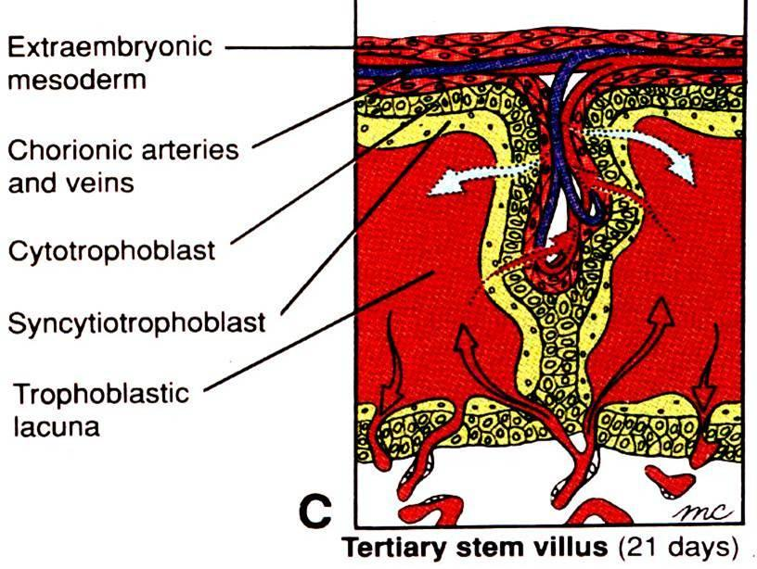

Slide 6
Outer most layer of blasto cyst is called trophoblast.
Trophoblast divides into syncitiotrophoblast and
cytotrophoblast. Syncitiotrophoblast is near the side
of the mother.
Trophoblast invades maternal tissues (Decidua) and
blood vessels and forms villi.
Primary, secondary and tertiary villi are present.
Primary villi has only syncitio and cytotrophoblast cells.
Secondary has extra embryonic mesoderm in addition to above two layers.
Tertiary villi has Syncytiotrophoblast, Cytotrophoblast, extra embryonic mesoderm and blood vessels.
The blood vessels grow into the villi from the foetus.

Slide 7
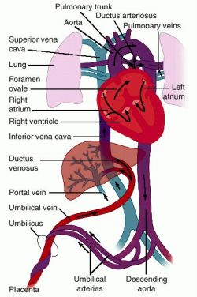
Foetal Circulation-
Umbilical veins carry 80% oxygen saturated blood from placenta.
Majority passes through ductus venosus of the liver and some through portal circulation to enter inferior venacava.
Majority of blood From right atrium enters the left atrium through foramen ovale. Some gets diverted to the right ventricle.
Blood coming from SVC is directed to right ventricle.

Slide 8
Blood which enters the left atrium mixes with blood coming from lungs and enter left ventricle.
From left ventricle the blood pass to the aorta.
Blood from right ventricle pass to the pulmonary artery.
Majority of blood pass through ductus arteriosus into the descending aorta but some enter the pulmonary circulation

Slide 9
Blood after entering the descending aorta passes through two umbilical arteries to the placenta.
Oxygen saturation in umbilical arteries is 58%.
Sites of mixing of blood
Liver,
inferior venacava
Right and left atria
Descending aorta

Slide 10
Changes that occur at birth –
1. Closure of umbilical arteries. –
Few minutes after birth due to smooth muscle contraction.
Change of oxygen tension, temperature and mechanical stimuli
Fibrous obliteration takes 2-3 months.
They become median umbilical ligaments. The proximal portions remain as superior vesicle arteries.

Slide 11
2. Closure of umbilical vein and ductus venosus-
Umbilical vein becomes ligamentum teres
Ductus venosus becomes ligamentum venosum
3. Closure of ductus arteriosus –
Immediately after birth due to contraction of muscular wall mediated by bradykinin released from lungs. Complete obstruction due to proliferation of intima takes 1-3 months. Then it becomes ligamentum arteriosum.
4. Closure of oval foramen –
Due to increase pressure of left atrium septum primum fuses with septum secundum.
First few days it is reversible
Complete fusion may take about 1 year.

